Slide 1


CAIN
AI-powered notebook assistant

Slide 2



Our Team
Phung Minh Chien
Ma Khoa Hoc
Nguyen Danh Huy
20213565
20210388
20213571

Slide 3
Our Name
Value Proposition
"CAIN" means...
🔍 Clarifying complexities in your documents
🤖 Adapting to your questions with smart, relevant responses
🌐 Interacting seamlessly to meet your needs
🤝 Navigating you through knowledge effortlessly
Our one-liner is "Your intelligent assistant for document insights and streamlined workflows."
CAIN is a revolutionary chatbot designed to simplify document management by offering precise summaries, accurate queries, and effortless navigation. It transforms how you interact with and understand your documents, saving time and enhancing productivity.

Slide 4


Overview
Introduction
01
Problems
02
Research Market
03
Ethical Considerations
04
Forgotten and Backstabber
05
Tasks
06
Storyboards
07

Slide 5

Introduction
CAIN is an AI-powered notebook assistant that helps you interact with documents, automate tasks, and improve your workflow through conversation.

Slide 6

Problems
The chatbot for document management and retrieving information. It simplifies onboarding, separates file handling from chats and ensures accessibility with inclusive design.
The User
Problem
Solution
Novice users seeking simplicity.
Expert users needing advanced tools like document information retriever.
Teams or individuals managing large or complex documents.
Difficulty retrieving specific information in large documents.
Uncomfortable experience while working with only 1 document in a chat.
Lack of user-friendly and accessible interface.
A chatbot with natural language queries for quick searches.
Tools for document summarization, deeply understand about the document
Intuitive, and accessible design for diverse user needs.

Slide 7


RESEARCH MARKET

Slide 8

NotebookLM
What Works in NotebookLM:
Advanced Import Options: NotebookLM allows users to import diverse sources, including PDFs, YouTube links, and URLs, making it versatile for content exploration and integration.
Smart Summarization and Guides: It can generate detailed outputs like study guides, FAQs, and outlines, which are tailored to user needs. This could be highly engaging for research-oriented tasks.
Audio Feature: NotebookLM offers podcast-style audio overviews of content, leveraging simulated conversational voices, which could appeal to auditory learners or users with limited time.
Citations and Analysis: It provides detailed source references, helping users maintain trust and transparency while ensuring information accuracy.

Slide 9
NotebookLM
Areas for Improvement in Our Chatbot Inspired by NotebookLM:
Enhanced Media Support: Your chatbot could integrate the ability to handle multiple media formats (e.g., importing YouTube videos or website links) and extract meaningful insights, similar to NotebookLM's video and text analysis.
Output Versatility: Adding features like FAQs, summaries, or study guides tailored to the user's needs could significantly improve usability. Providing structured outputs beyond Q&A enhances the user's interaction.
Audio Summarization: Incorporating an audio overview feature would diversify the ways users engage with content, making your chatbot more inclusive.
Content Differentiation: NotebookLM identifies gaps and suggests unique angles when analyzing competitor content. Adding a similar capability can position your chatbot as a tool for competitive intelligence.

Slide 10


Ethical Considerations
Direct Stakeholders
Indirect Stakeholders
End Users: Novice, advanced, and expert users interacting with the chatbot.
Development Team: Designers, developers, and testers building and maintaining the chatbot.
Organizations: Companies benefiting from increased employee productivity due to the chatbot.
Team Leads or Managers: Those overseeing projects where the chatbot improves workflow.
Customers or Clients: Indirectly benefit from faster, more accurate work by users leveraging the chatbot.

Slide 11
The Forgotten
When you picture your user base, who is excluded? If they used your product, what would their experience be like?
Who is Excluded?
Non-digital users without access to devices or the internet.
Technologically inexperienced or non-literate users.
Users with disabilities needing assistive technologies.
Their Experience:
Non-digital users cannot access the chatbot.
Inexperienced or non-literate users may find it confusing or unusable.
Users with disabilities might struggle without strong accessibility features.
Improving onboarding, accessibility, and language support could help include these groups.

Slide 12
The Backstabber
What could cause people to lose trust in your product?
Causes of Trust Loss:
Inaccurate responses or misleading information.
Poor data security leading to privacy concerns.
Unreliable performance, like crashes or delays.
Overly complex interface or limited language support.
Implications:
Users may abandon the product for competitors.
Reputation damage could reduce adoption rates.
Organizations may avoid using the chatbot for sensitive tasks.

Slide 13
TASKS

Slide 14

Simple
Find notebook by the name of the notebook in account.
.
01
Tasks
Moderate
User want to create notebook by entering name
The users want chatbot answer specific questions from within a document’s content.
02
Complex
User wants to upload document file to notebook
03

Slide 15
STORYBOARDS

Slide 16
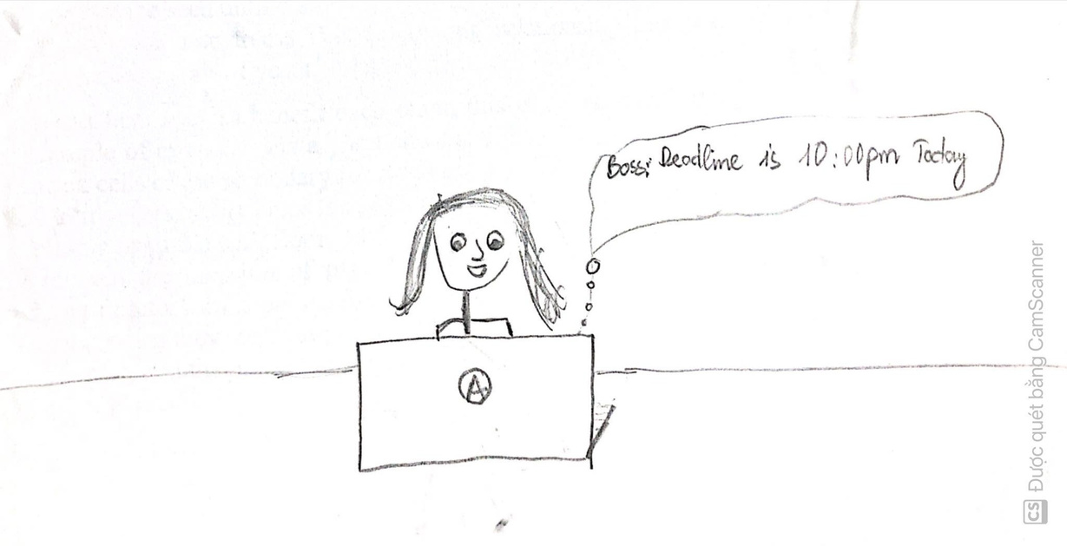

1
2
1.Mary is an office worker who regularly works with long and complex digital documents. One day, she is assigned to complete a task of answering questions whose answers are contained in documents and summarizing those documents.
2. Because she was given too much work, she forgot about the work her boss assigned her today, while the deadline was approaching.

Slide 17
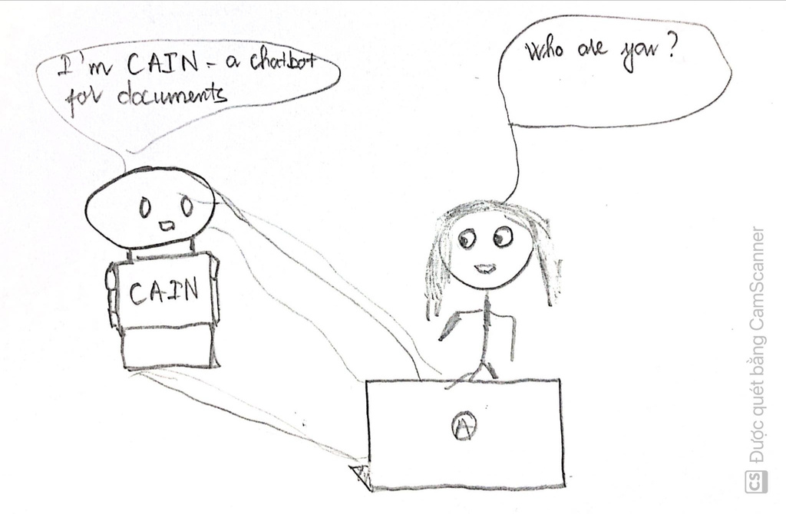
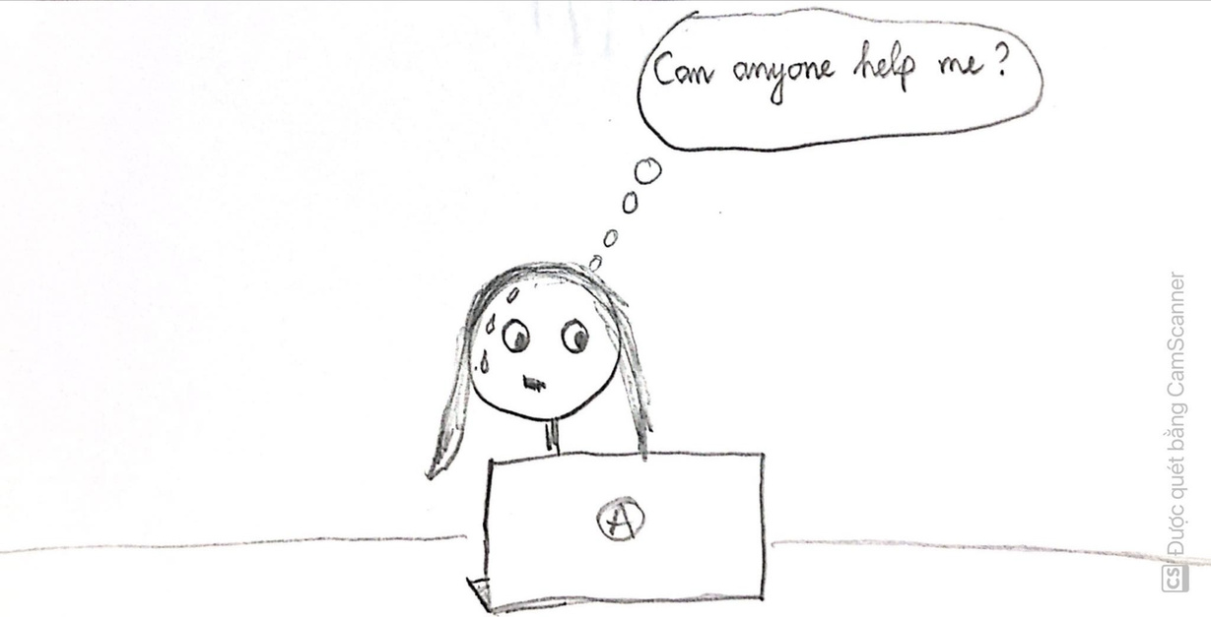
3
4
3. She is extremely worried and would like someone to help her answer questions regarding this document.
4.Just as she was about to give up, a chatbot named CAIN appeared on her computer screen that could help her answer questions related to her documents.

Slide 18
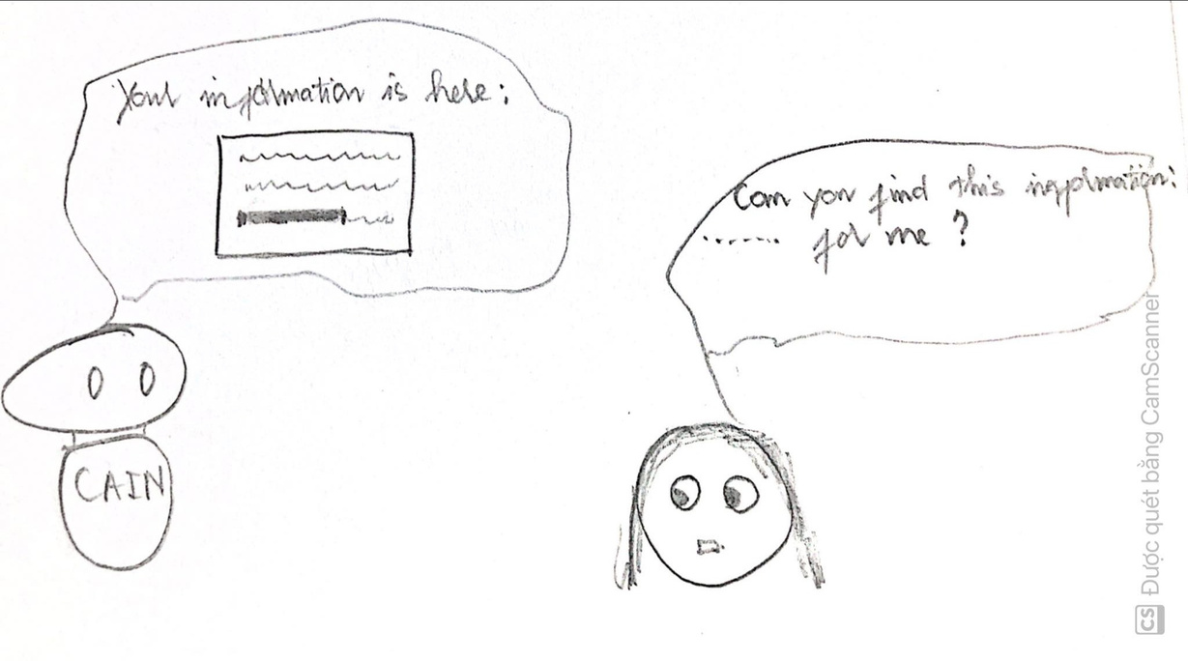
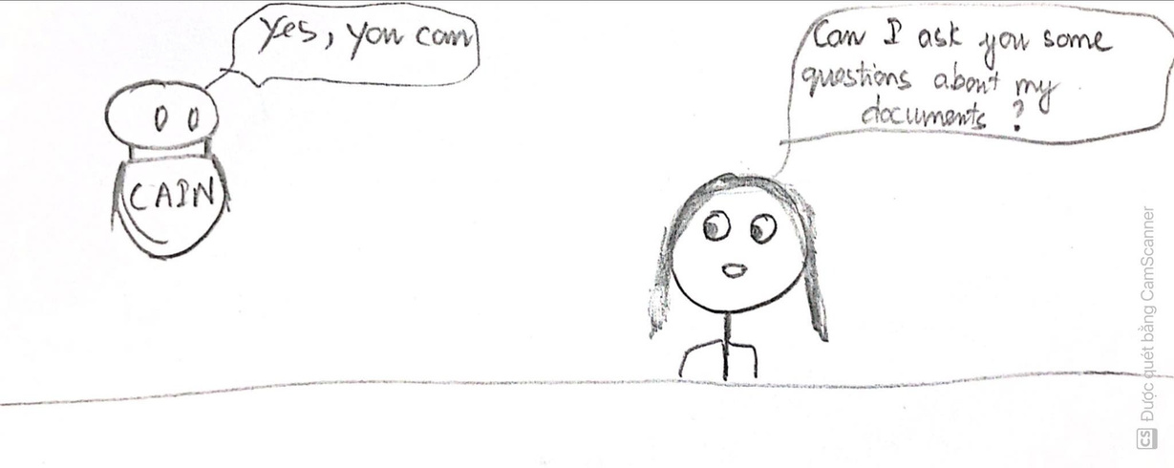
5
6
5 .She felt less anxious when CAIN was able to help her with a few questions about the documentation.
6. CAIN was able to respond and find information in documents quickly and very accurately, which made her very satisfied.

Slide 19
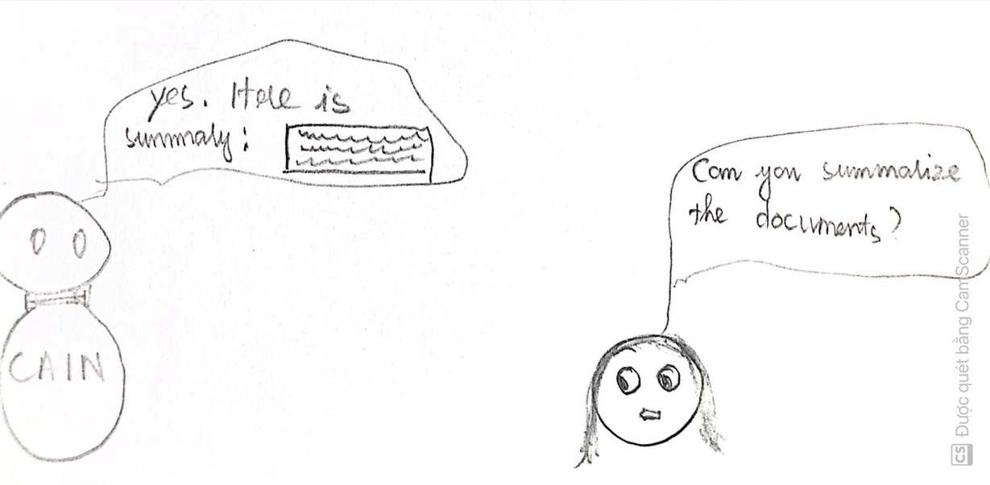
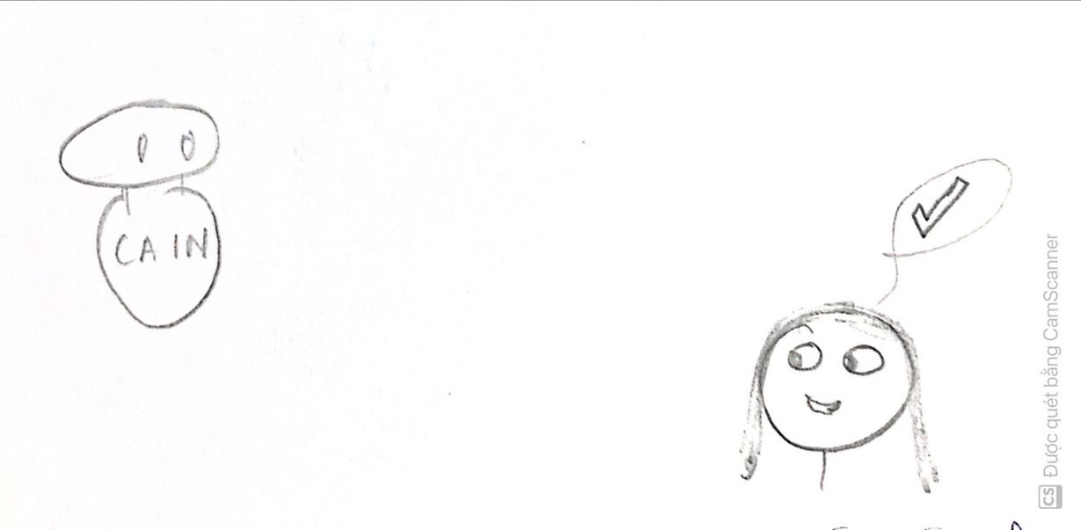
7
8
7. Mary felt very happy that CAIN found exactly the information he was looking for and she felt more confident in CAIN.
8. Mary continued to ask CAIN to summarize the content of the document for her and CAIN did it very quickly for her.

Slide 20

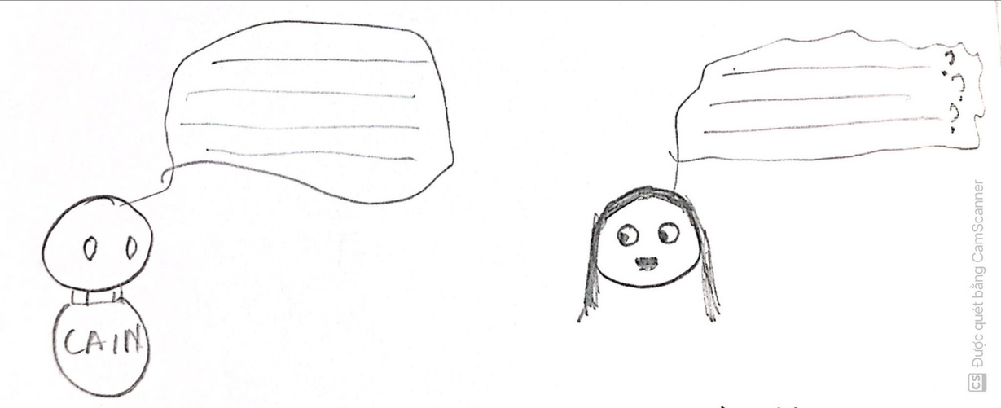
9
10
9. Mary was surprised that CAIN was able to summarize such a long document.
10.Mary continued to ask questions regarding the documents that the boss had given her and CAIN continued to answer those questions.

Slide 21
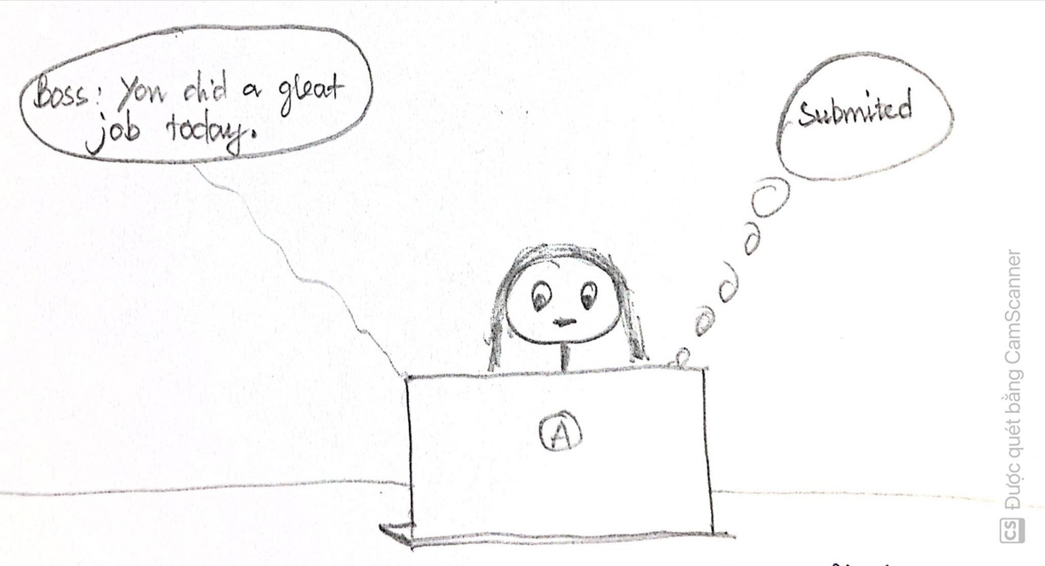
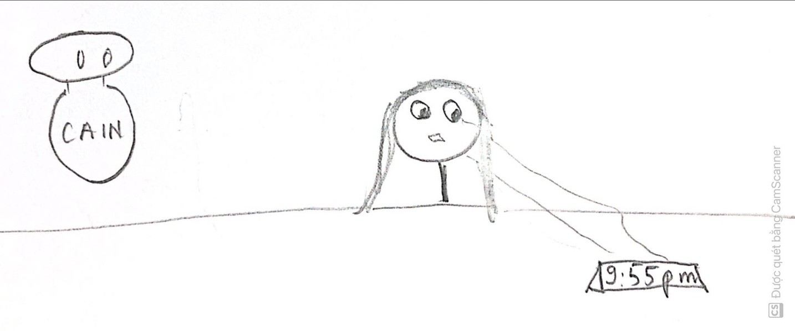
11
12
11. There were only 5 minutes left until the deadline and luckily, Mary completed the task that her boss had assigned thanks to CAIN.
12. Finally, Mary submitted the assignment on time, completed the assigned task excellently and received praise from the boss.

Slide 22
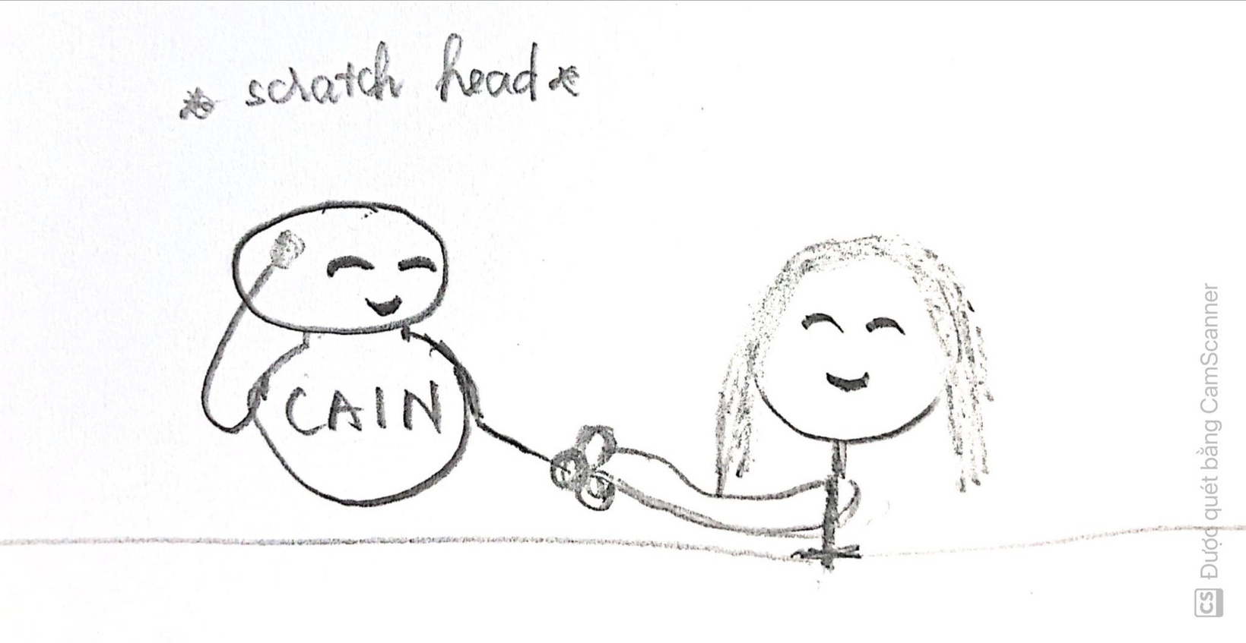
13
13. Mary thanks Cain for helping her so much with her document work today.

Slide 23

CAIN(Chien AI notebook)
Connecting Answers & Inspiring New possibilities

Slide 24

THANK YOU!

